Slide 1

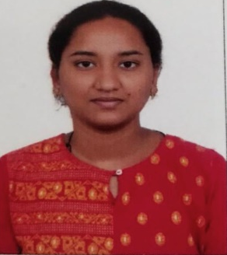





Meghana K
Education and certificates
Bachelor of Technology
Electronics & communication :2016- 2021
Analyst/Software Engineer
Base Location: Pune
Skills
java 8 /J2EE: Java basics, OOPs, Generics, collections, Stream API, Junit, Servlets.
Spring Rest : REST controllers, Implementation of GET, POST, PUT & DELETE, Bean validation & Testing Services, Controller & Repository Layer.
Spring Boot Microservices : Spring Boot Starters, annotations, Messaging Service, Swagger API documents.
React : Components, Hooks, Event handling , Material UI, Routing.
Angular : basics
Database : MYSQL
UI Technology : HTML 5 & CSS 3, JavaScript
Tools : GitHub, Postman, Eclipse, Maven.
Email ID:
Meghana.a.k@capgemini.com
_{Mobile No:} +91 8296383843
Grade:
A4
Strengths
Good Knowledge in Java Concepts
Hands on Experience in creating Web Application, Java, STS, Rest API, React.
Hands on Experience in developing web pages using HTML5 & CSS3.
experience in developing and maintaining Client/Server, Web based Applications and Web Development. Working experience in UI development. Worked on Angular framework. Experience in creating responsive web pages and web apps. Knowledge of Rest API. .
Achivement
Online food ordering System Application
Completed end to end case study of Online food ordering system. I have taken the responsibility of developing rest API's, build reusable course and libraries for future reference. Developing and implementing front end architecture and bug fixing.
Coded and designed Static Web Pages (training)
Developed website with HTML5 and CSS3 Along Frameworks like React and Angular.
Amazon cloud Practitioner
Completed and got certified in Amazon cloud Practitioner
Additional Details
Excellent Communication Skills
Team Player
Check out my work on GitHub & Video Profile
Presentation Title | Author | Date © Capgemini 2017. All rights reserved | 1

